Slide 1




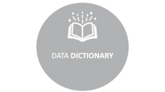
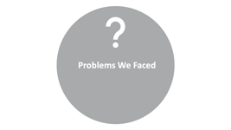
ANALYSIS OF INSECTS
BY
COMMAND Z
Blen Buticho
Eyoel Mulugeta

Slide 2

DATA DICTIONARY

Slide 3


DATA DICTIONARY
Lady Bug Data
Species - is a group of organisms that can reproduce with one another in nature and produce fertile offspring.
Genus: A principal taxonomic category that ranks above species and below family
Scan Code- Each species is assigned a special code
Collector: the individual who collected the insects
Identifier: the individual who determined the species type
Country: the nation where the insects were gathered
State: the state where the insects were gathered

Slide 4
DATA DICTIONARY
Cabbage Butterfly
Core ID - For each species, a special identifying code is assigned
RW length- measures taken from the top to the bottom of the right wing
RW width - the dimensions of the right wing from the point where it joins the body to the apex
RW Apex A - right wing's highest point
LW Length - measures taken from the top to the bottom of the left wing
LW width - the dimensions of the left wing from the point where it joins the body to the apex
LW Apex A - left wing's highest point
Country- nation from which the species were taken

Slide 5

Ladybug Data

Slide 6


Ladybug Data
KEY COLUMNS
Species
Plot
A_E_V
Date
Coordinates
Collector
Identifier
Scan code

Slide 7
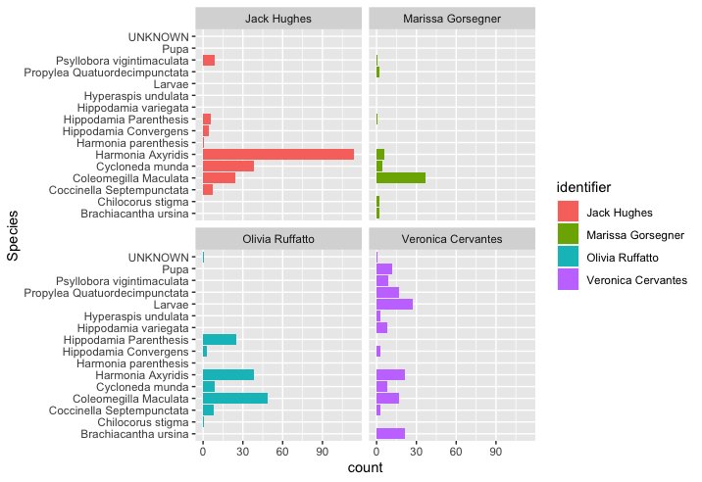
ANALYSIS OF LADYBUG DATA

Slide 8
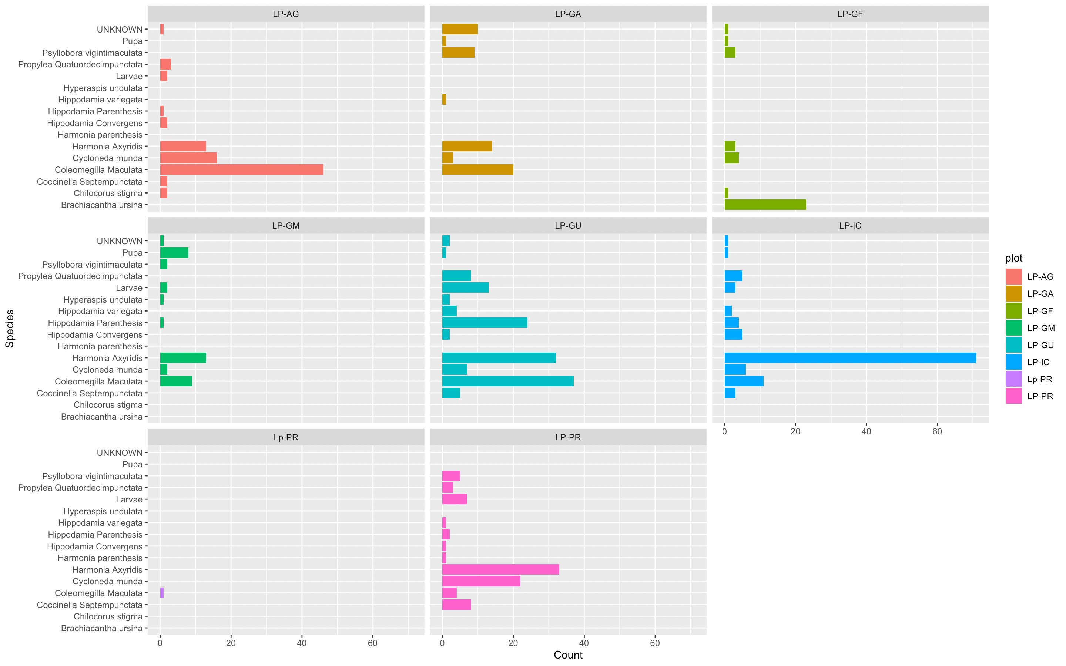
ANALYSIS OF LADYBUG DATA

Slide 9
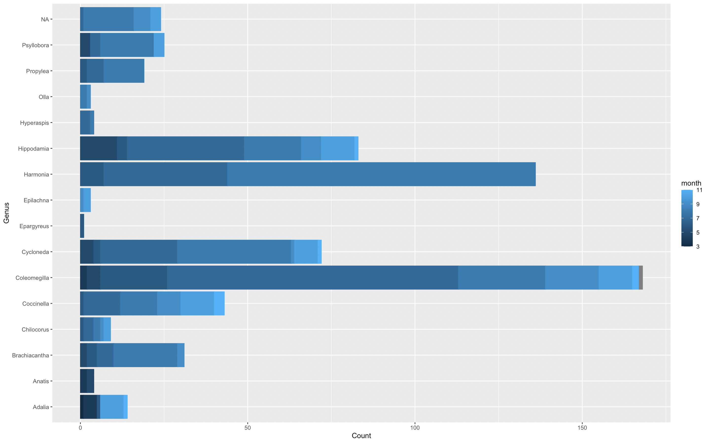
ANALYSIS OF LADYBUG DATA

Slide 10

Butterfly Data

Slide 11
Butterfly Data
KEY COLUMNS
Sex
Location
Date
Wing length/width
Apex Area
Left anterior Spot
Right anterior Spot
Longitude
Latitude

Slide 12
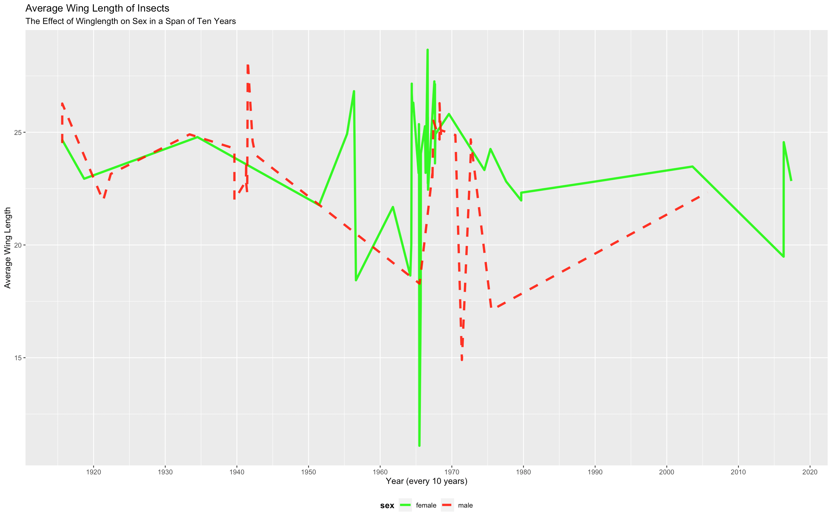

Slide 13
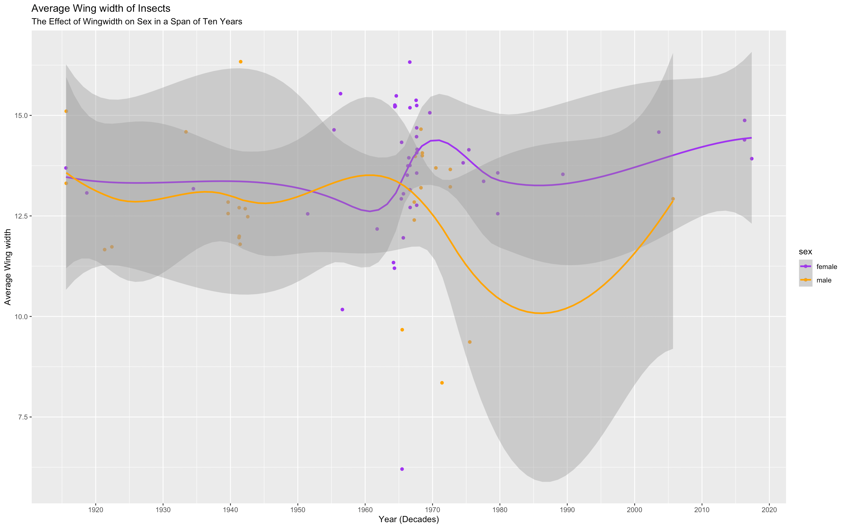

Slide 14
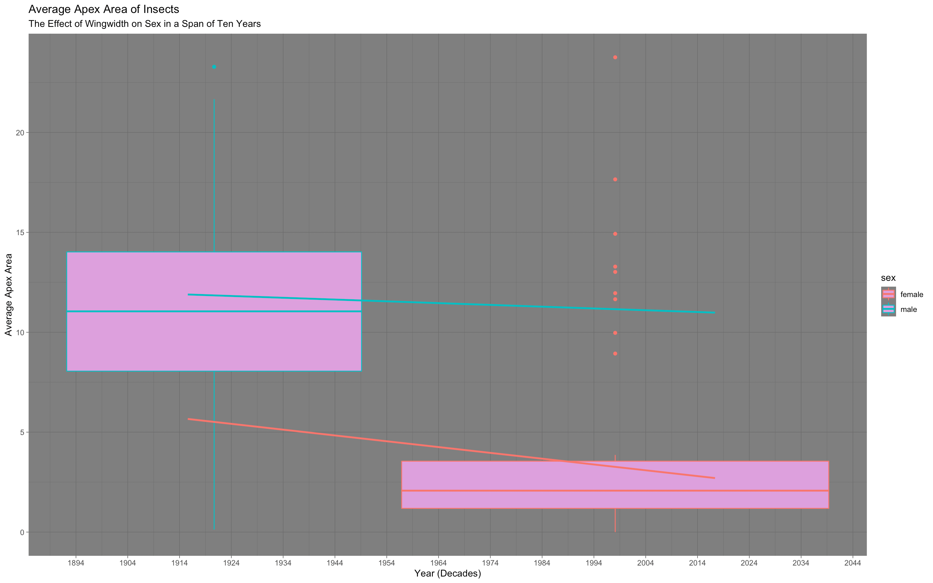

Slide 15
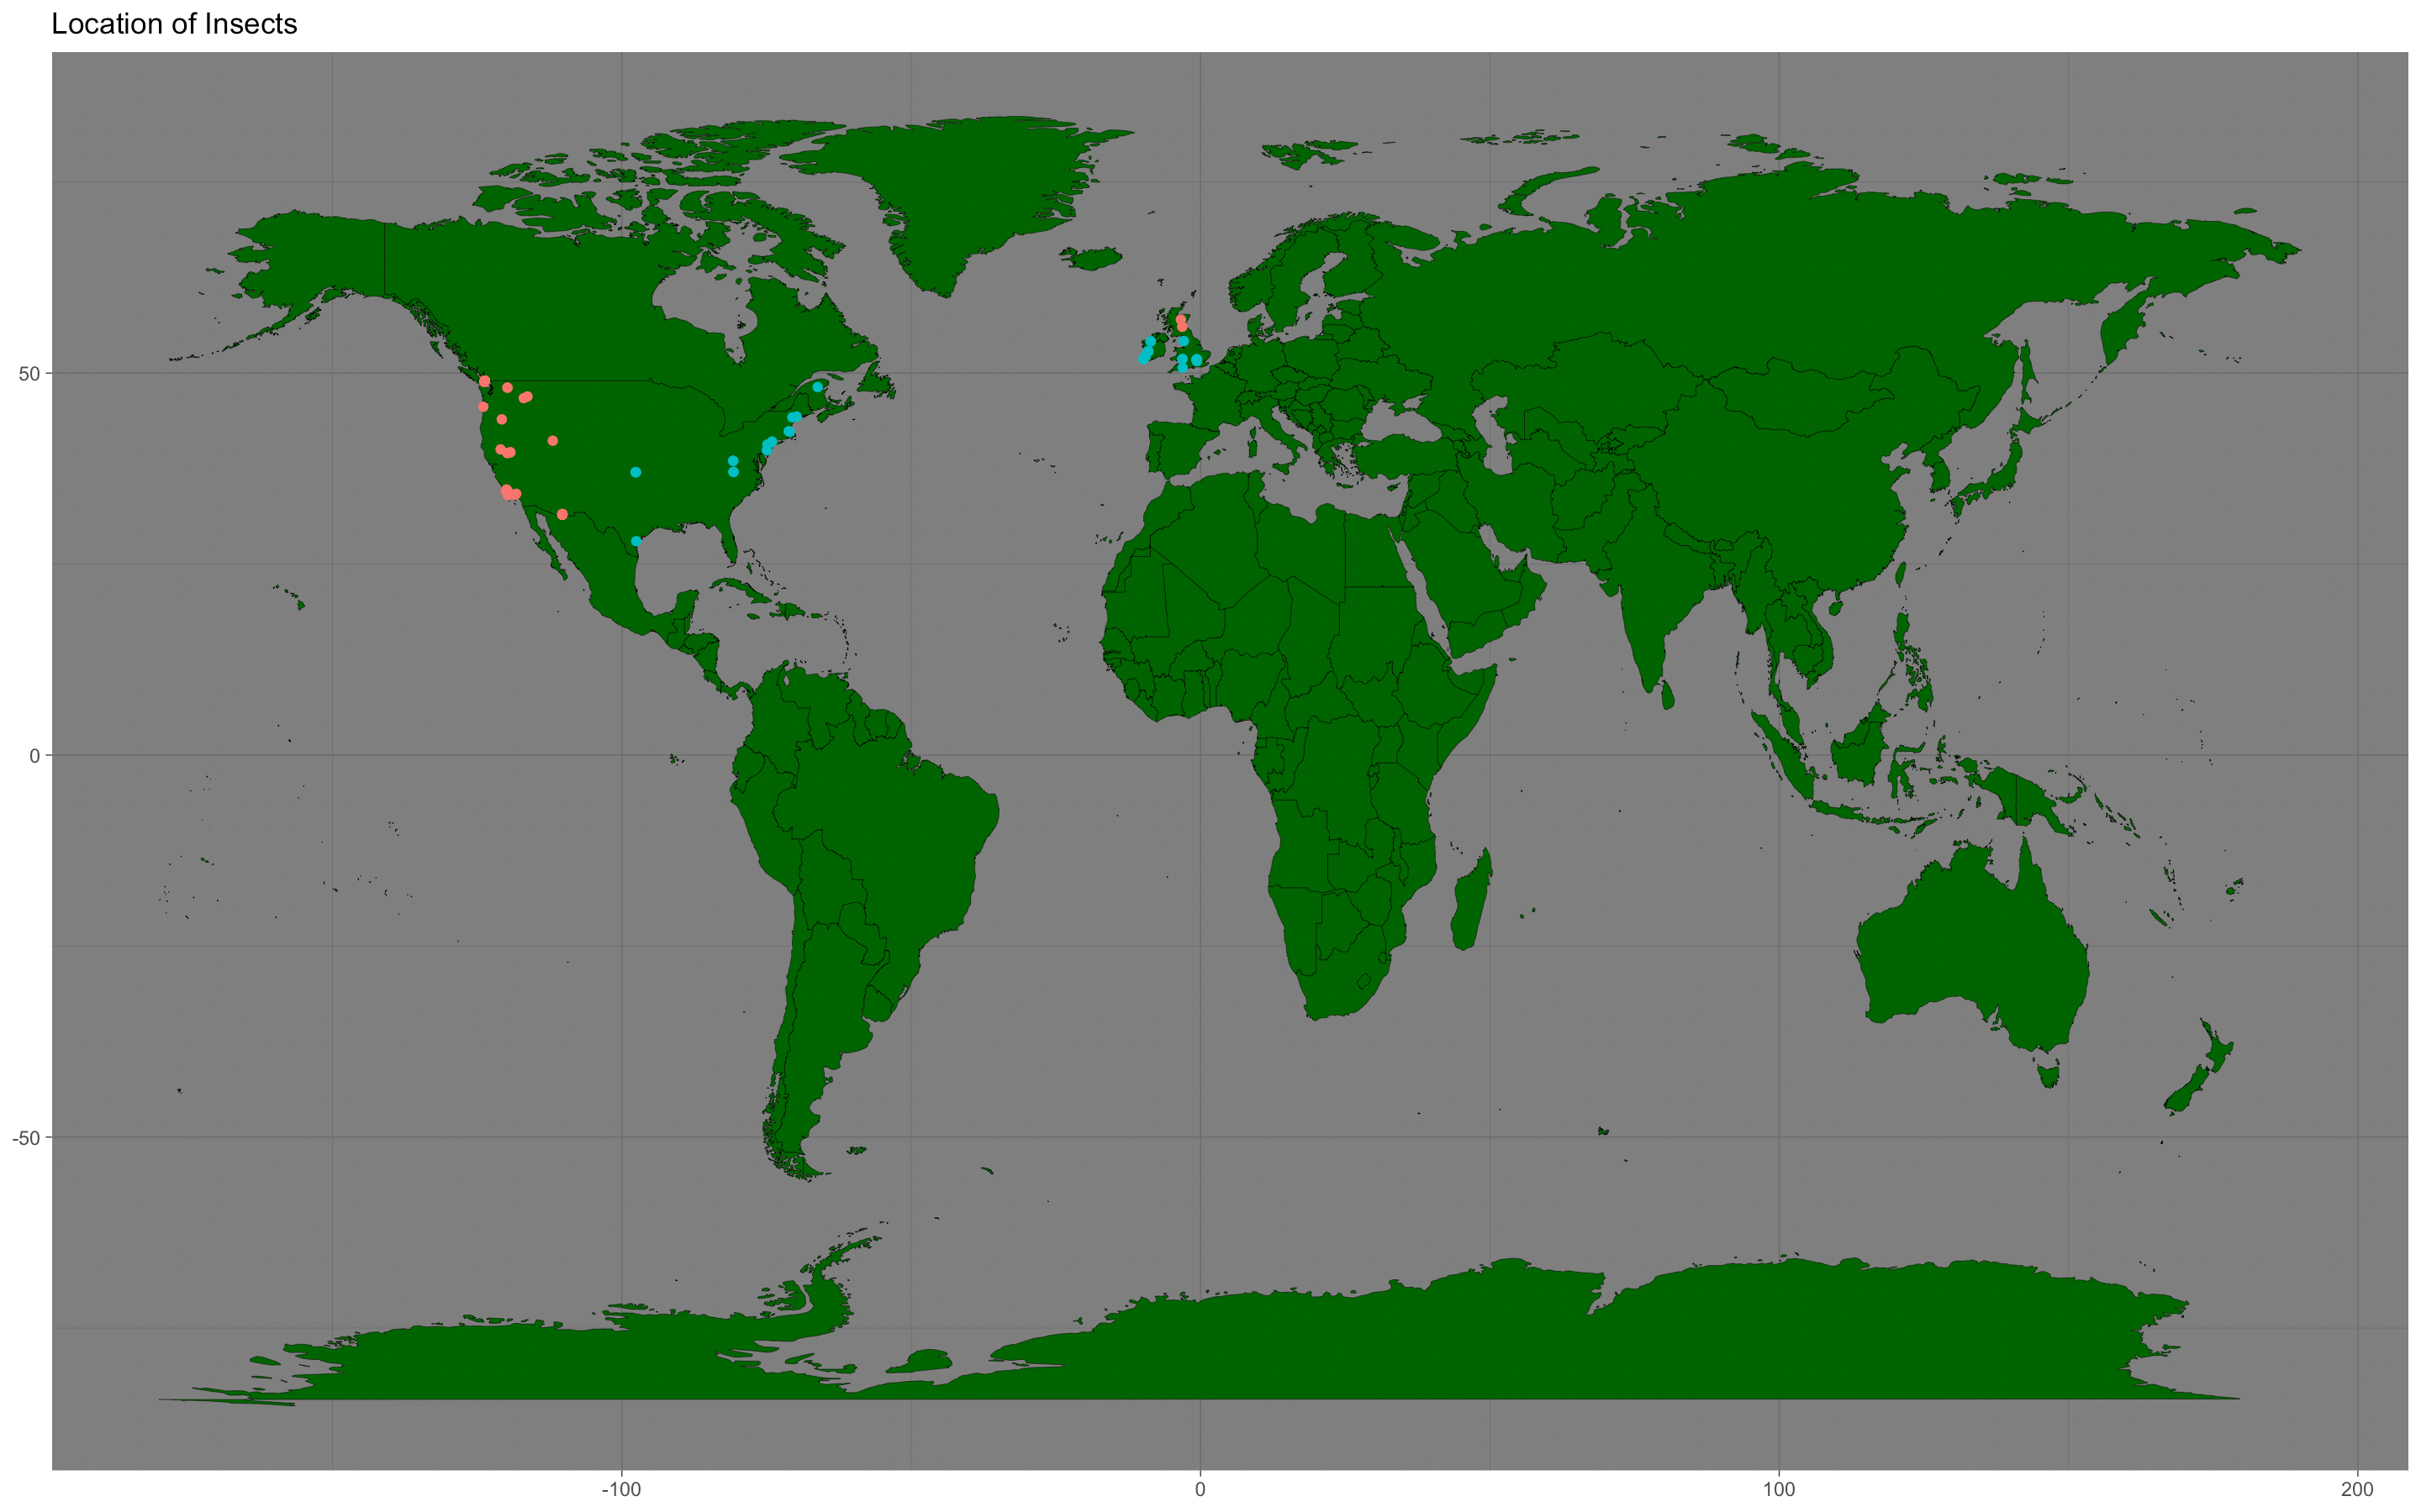
Butterfly Data

Slide 16
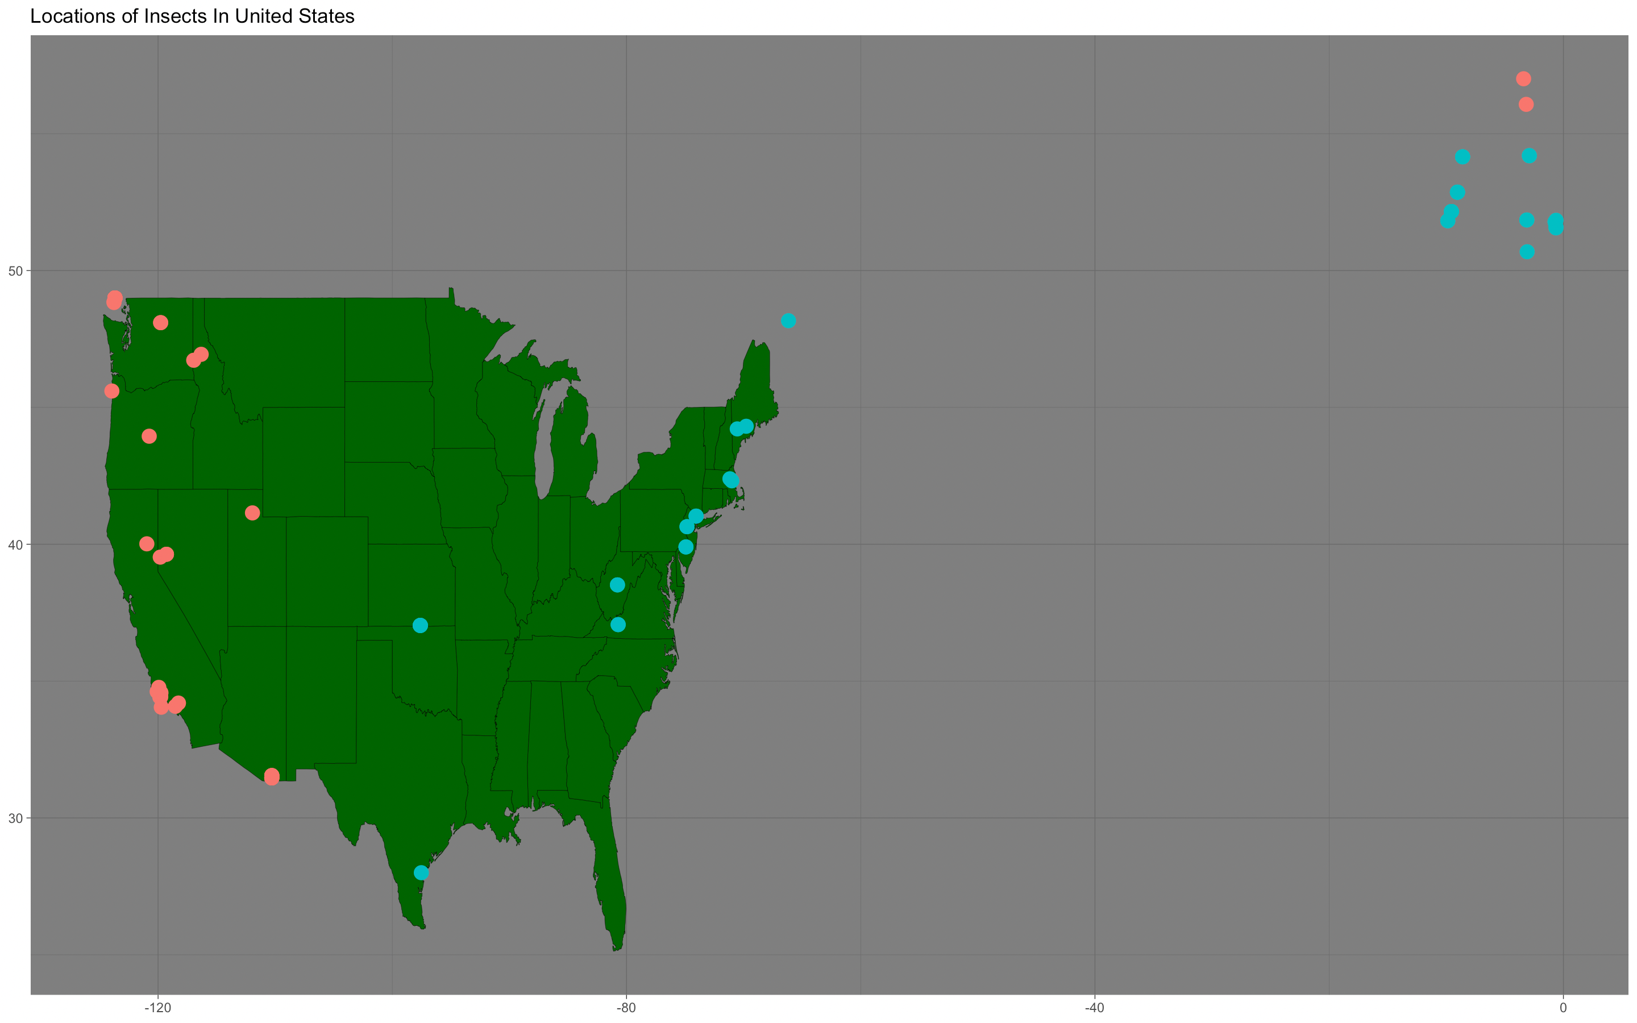
Butterfly Data

Slide 17

Problems We Faced

Slide 18

Problems We faced Doing The Butterfly Data
Existing of null values
Scan ladybug data had inadequate database design
Renaming each name of identifier before finding if else statement
Problems we faced Doing The Butterfly Data
Determining the importance of the columns that we needed to use
Several outliers
Data kept renaming itself, so we had to rename each column.

Slide 19

Conclusion

Slide 20
Conclusion
Despite the time required for data cleansing, it is crucial to analyze any data.
When doing a plot, Aesthetics is really important. It helps user understand the analysis better.
Data can be analyzed using several tools.

